Slide 1

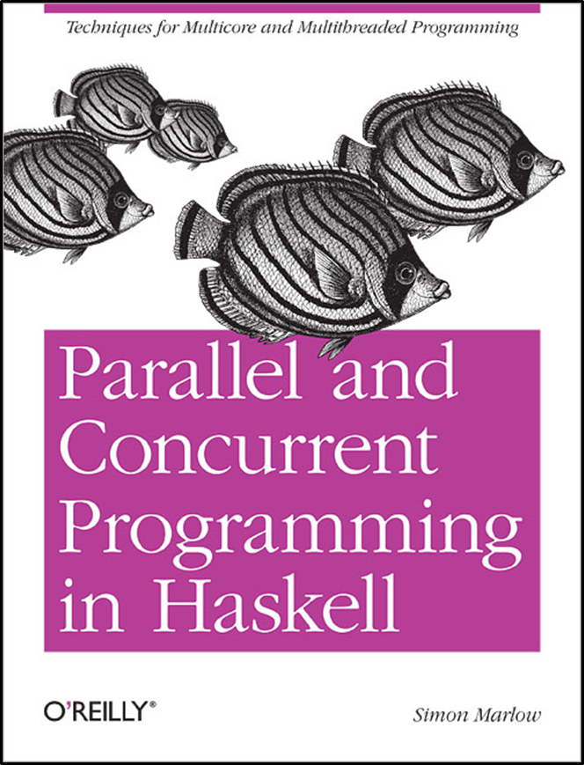

IMPLEMENTAREA CONCURENTEI IN LIMBAJE DE PROGRAMARE
Concurenta
Threaduri
Memorie Partajata
Ioana Leustean
Part II. Concurrent Haskell
Cap.7 & 8
https://hackage.haskell.org/package/base-4.20.0.1/docs/Control-Concurrent.html

Slide 2
Atomicitate
Modalități de sincronizare de nivel scăzut: variabile atomice
Atomicitate fără sincronizare. mult mai rapide decât cu locks
Java: AtomicInteger, AtomicBoolean, …
get(), set(), incrementAndGet(), addAndGet(int d), compareAndSet(int old, int new)
Haskell: IORef a
newIORef, readIORef, writeIORef, atomicModifyIORef, atomicWriteIORef
Metodele sunt implementate folosind instrucțiuni hardware compare-and-swap
Modalitati de sincronizare de nivel inalt: Software Transactional Memory (STM)
sincronizare fara lacate
blocuri de instructiuni executate atomic

Slide 3
Exemplu: o tranzactie bancara(I)
type Account = MVar Int
deposit :: Account -> Int -> IO() -- depunere
deposit acc amount = do
x <- takeMVar acc
putMVar acc (x + amount)
withdraw :: Account -> Int -> IO() -- retragere
withdraw acc amount = do
x <- takeMVar acc
putMVar acc (x - amount)
showBalance :: Account -> String -> IO() -- sold
showBalance acc str = do
x <- takeMVar acc
putMVar acc x
putStrLn ("Contul " ++ str ++ ": " ++ (show x))

Slide 4
Exemplu: o tranzactie bancara (I)
import Control.Concurrent
import Control.Monad
type Account = MVar Int)
main = do
aMVar <- newMVar 1000
bMVar <- newMVar 1000
forkIO(transfer aMVar bMVar 300)
forkIO (transfer bMVar aMVar 500)
showBalance aMVar "a"
showBalance bMVar "b"
transfer :: Account -> Account -> Int -> IO()
transfer from to amount = do
withdraw from amount
deposit to amount
data race
un alt thread ar putea observa o stare
in care banii nu se gasesc in nici un cont

Slide 5
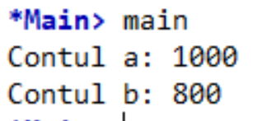
Exemplu: o tranzactie bancara (I)
transfer :: Account -> Account -> Int -> IO()
transfer from to amount = do
withdraw from amount
-- threadDelay (5^6)
deposit to amount
transfer :: Account -> Account -> Int -> IO()
transfer from to amount = do
withdraw from amount
-- threadDelay (5^6)
deposit to amount
compunerea unor
operatii corecte
poate avea ca rezultat o
operatie eronata
main = do
aMVar <- newMVar 1000
bMVar <- newMVar 1000
forkIO(transfer aMVar bMVar 300)
forkIO (transfer bMVar aMVar 500)
showBalance aMVar "a"
showBalance bMVar "b"

Slide 6
STM
"Software transactional memory (STM) is a technique for simplifying concurrent programming by allowing multiple state-changing operations to be grouped together and performed as a single atomic operation. Strictly speaking, “software transactional memory” is an implementation technique, whereas the language construct we are interested in is “atomic blocks.”"
S. Marlow, PCHP
"A transaction is a finite sequence of machine instructions, executed by a single process, satisfying the following properties:
Serializability: Transactions appear to execute serially, meaning that the steps of one transaction never
appear to be interleaved with the steps of another. Committed transactions are never observed by different processors to execute indifferent orders.
Atomicity: Each transaction makes a sequence of tentative changes to shared memory. When the
transaction completes, it either commits, making its changes visible to other processes (effectively) instantaneously, or it aborts, causing its changes to be discarded."
Maurice Herlihy, J. Eliot B. Moss Transactional memory: architectural support for lock-free data structures. Isca '93. ACM SIGARCH Computer Architecture News - Special Issue: Proceedings of the 20th annual international symposium on Computer architecture (ISCA '93). May 1993

Slide 7
STM: Tranzactii bancare
transfer :: Account -> Account -> Int -> IO()
transfer from to amount = atomically $ do
withdraw from amount
deposit to amount
atomically
"takes an action as its argument, and performs it atomically.
More precisely, it makes two guarantees:
Atomicity: the effects of atomically act become
visible to another thread all at once.
This ensures that no other thread can see
a state in which money has been deposited
in to but not yet withdrawn from from.
Isolation: during a call atomically act,
the action act is completely unaffected
by other threads. It is as if act takes
a snapshot of the state of the world
when it begins running, and then executes
against that snapshot."
Simon Peyton Jones, Beautiful Concurrency

Slide 8
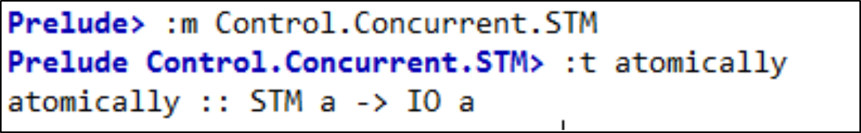
Monada STM
este asemanatoare monadei IO
TVar
variabile tranzactionale
type Account = TVar Int
deposit :: Account -> Int -> STM ()
deposit acc amount = do
x <- readTVar acc
writeTVar acc (x + amount)
withdraw :: Account -> Int -> STM ()
withdraw acc amount = do
x <- readTVar acc
writeTVar acc (x - amount)
deposit
actiune STM
withdraw
actiune STM
transfer :: Account -> Account -> Int -> IO()
transfer from to amount = atomically $ do
withdraw from amount
deposit to amount
atomically :: STM a -> IO a
executa atomic o actiune STM

Slide 9
Monada STM
Operatiile de baza ale monadei STM sunt
scrierea si citirea variabilelor tranzactionale.
Variabilele tranzactionale sunt mutabile.
O variabila TVar nu poate fi goala.
Scrierea si citirea variabilelor tranzactionale
se face fara blocare.
Actiunile STM au loc atomic.
O tranzactie este o actiune STM care este
executata in monada IO folosind atomically
data STM a
instance Monad STM
atomically :: STM a -> IO a
data TVar a
newTVar :: a -> STM (TVar a)
readTVar :: TVar a -> STM a
writeTVar :: TVar a -> a -> STM ()

Slide 10
Monada STM
"Why is STM a different monad from IO?
The STM implementation relies on being able to roll
back the effects of a transaction in the event of a
conflict with another transaction [..]. A transaction can be rolled back only if we can track exactly what effects it has, and this would not be possible if arbitrary I/O were allowed inside a transaction—we might have performed some
I/O that cannot be undone, like making a noise or launching some missiles."
S.Marlow, PCHP
data STM a
instance Monad STM
atomically :: STM a -> IO a
data TVar a
newTVar :: a -> STM (TVar a)
readTVar :: TVar a -> STM a
writeTVar :: TVar a -> a -> STM ()

Slide 11
Implementarea STM
"One particularly attractive implementation is well established in the database world, namely optimistic execution. When (atomically act) is performed, a thread-local transaction log is allocated, initially empty. Then the action act is performed, without taking any locks at all. While performing act, each call to writeTVar writes the address of the TVar and its new value into the log; it does not write to the TVar itself. Each call to readTVar first searches the log (in case the TVar was written by an earlier call to writeTVar); if no such record is found, the value is read from the TVar itself, and the TVar and value read are recorded in the log. In the meantime, other threads might be running their own atomic blocks, reading and writing TVars like crazy.
When the action act is finished, the implementation first validates the log and, if validation is successful, commits the log. The validation step examines each readTVar recorded in the log, and checks that the value in the log matches the value currently in the real TVar. If so, validation succeeds, and the commit step takes all the writes recorded in the log and writes them into the real TVars.
What if validation fails? Then the transaction has had an inconsistent view of memory. So we abort the transaction, re-initialise the log, and run act all over again"
Simon Peyton Jones, Beautiful Concurrency

Slide 12
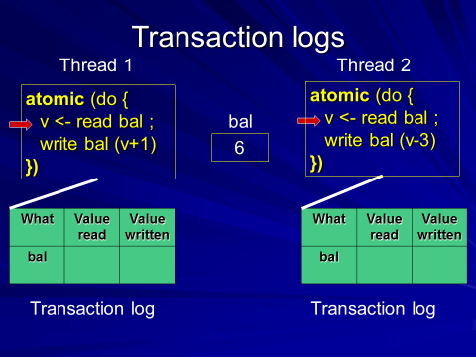
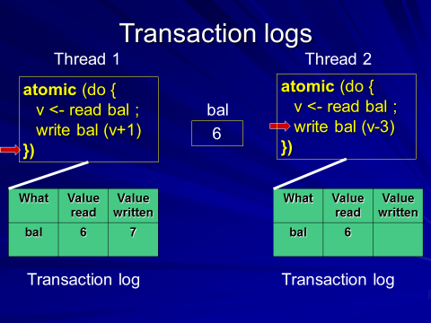
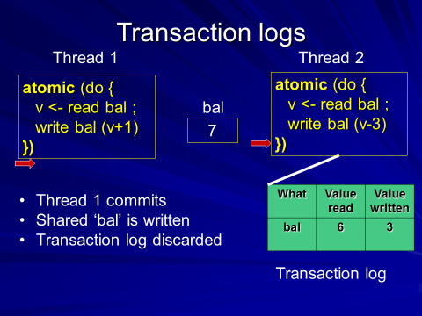
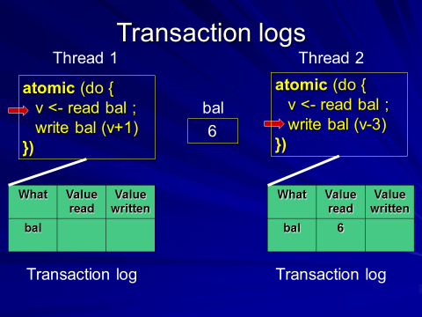

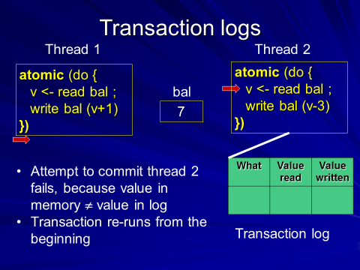
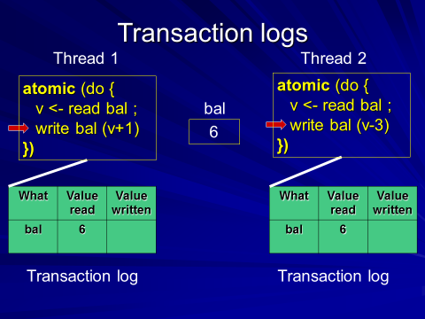
1
6
4
2
7
5
3
T. Harris, M. Herlihy, S. Marlow, S. Peyton Jones,
Concurrency unlocked
click pe prezentare

Slide 13
Variabile mutabile: IORef, MVar, TVar
import Data.IORef
-- variabile mutabile in monada IO
newIORef :: a -> IO (IORef a)
readIORef :: IORef a -> IO a
writeIORef :: IORef a -> a -> IO ()
import Control.Concurrent.STM.TVar
-- variabile tranzactionale
-- variabile mutabile in monada STM
newTVar :: a -> STM (TVar a)
readTVar :: TVar a -> STM a
writeTVar :: TVar a -> a -> STM ()
add :: IORef Int -> Int -> IO()
add rref n = do
val <- readIORef rref
writeIORef rref
main = do
rref <- newIORef 0
add rref 10
val <- readIORef rref
print val
import Control.Concurrent.MVar
-- variabile de sincronizare
-- variabile mutabile in monada IO
newEmptyMVar :: IO (MVar a)
newMVar :: a -> IO (MVar a)
takeMVar :: MVar a -> IO a -- blocheaza thread-ul
putMVar :: MVar a -> a -> IO () -- blocheaza thread-ul

Slide 14
import Control.Concurrent
import Control.Monad
import Control.Concurrent.STM
type Account = TVar Int
deposit :: Account -> Int -> STM ()
deposit acc amount = do
x <- readTVar acc
writeTVar acc (x + amount)
withdraw :: Account -> Int -> STM ()
withdraw acc amount = do
x <- readTVar acc
writeTVar acc (x - amount)
showBalance :: Account -> String -> IO()
showBalance acc str = do
x <- atomically $ readTVar acc
putStrLn ("Contul " ++ str ++ ": " ++ (show x))
mybankstm.hs
transfer :: Account -> Account -> Int -> IO()
transfer from to amount = atomically $ do
withdraw from amount
deposit to amount
main = do
(a,b) <- atomically $ do
a <- newTVar 1000
b <- newTVar 1000
return (a,b)
forkIO(transfer a b 300)
forkIO (transfer b a 500)
showBalance a "a"
showBalance b "b"
compozitionalitate

Slide 15
Blocare (blocking)
"Suppose that a thread should block if it attempts to overdraw an account (i.e. withdraw more than the current balance). Situations like this are common in concurrent programs: for example, a thread should block
if it reads from an empty buffer, or when it waits for an event. We achieve this in STM by adding the single function retry, whose type is
The semantics of retry are simple: if a retry action is performed, the current transaction is abandoned and retried at some later time."
retry :: STM a
check :: Bool -> STM ()
check True = return ()
check False = retry
limitedWithdraw :: Account -> Int -> STM ()
limitedWithdraw acc amount = do
bal <- readTVar acc
if amount > 0 && amount > bal
then retry
else writeTVar acc (bal - amount)
.
limitedWithdraw :: Account -> Int -> STM ()
limitedWithdraw acc amount = do
bal <- readTVar acc
check (amount <= 0 || amount <= bal)
writeTVar acc (bal - amount)
sau
Simon Peyton Jones, Beautiful Concurrency
Notes:
Implementarea retry: threadul este blocat pana cand se face o scriere intr-o varaiabila TVar pe care threadul o citeste; atunci theradul este deblocat si se reia executia

Slide 16
Blocare (blocking)
"Suppose that a thread should block if it attempts to overdraw an account (i.e. withdraw more than the current balance). Situations like this are common in concurrent programs: for example, a thread should block
if it reads from an empty buffer, or when it waits for an event. We achieve this in STM by adding the single function retry, whose type is
The semantics of retry are simple: if a retry action is performed, the current transaction is abandoned and retried at some later time."
Simon Peyton Jones, Beautiful Concurrency
retry :: STM a
"The retry operation uses the transaction log to find out which TVars were accessed by the transaction,
because changes of any of these TVars must trigger a rerun of the current transaction.
Hence, each TVar has a watch list of threads that should be woken up if the TVar is modified and retry adds the
current thread to the watch list of all the TVars read during the current transaction."
S. Marlow, PCHP
.
Notes:
Implementarea retry: threadul este blocat pana cand se face o scriere intr-o varaiabila TVar pe care threadul o citeste; atunci theradul este deblocat si se reia executia

Slide 17
Alegerea (choice)
"Suppose you want to withdraw money from account A if it has enough money, but if not then withdraw it
from account B? For that, we need the ability to choose an alternative action if the first one retries.
To support choice, STM Haskell has one further primitive action, called orElse, whose type is
Its semantics are as follows: the action (orElse a1 a2) first performs a1;
if a1 retries (i.e. calls retry), it tries a2 instead;
if a2 also retries, the whole action retries. "
limitedWithdraw :: Account -> Int -> STM ()
limitedWithdraw acc amount = do
bal <- readTVar acc
if amount > 0 && amount > bal
then retry
else writeTVar acc (bal - amount)
limitedWithdraw2 :: Account -> Account -> Int -> STM ()
limitedWithdraw2 acc1 acc2 amt
= orElse (limitedWithdraw acc1 amt) (limitedWithdraw acc2 amt)
.
Exercitiu: Modificati mybankstm.hs adaugand retry si orElse
Simon Peyton Jones, Beautiful Concurrency

Slide 18
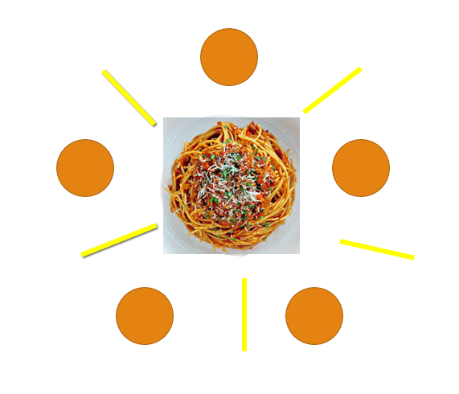
The Dining Philosophers
http://rosettacode.org/wiki/Dining_philosophers
http://www.tobiasmuehlbauer.com/2011/07/24/stm-haskell-dining-philosophers-problem/
http://www-ps.informatik.uni-kiel.de/~fhu/projects/stm.pdf

Slide 19
Dining Philosophers
Fiecare filozof executa
la infinit urmatorul ciclu
n = numarul de filozofi
asteapta sa manance
ia furculita stanga
Ia furculita dreapta
mananca
elibereaza furculita stanga
elibereaza furculita dreapta
mediteaza
i(mod n)
Phil i
i+1 (mod n)

Slide 20
Fiecare filozof executa la infinit urmatorul ciclu
-- asteapta sa manance
mananca
mediteaza
ia furculita stanga
Ia furculita dreapta
actiuni atomice - elimina
deadlock
elibereaza furculita stanga
elibereaza furculita dreapta
durata finita – elimina
starvation

Slide 21
Dining Philosophers – varianta 1
dinnersrc1.hs
Fork
b :: Bool
s :: TVar
type Fork = TVar Bool
takeFork :: Fork -> STM ()
takeFork s = do
b <- readTVar s
if b then writeTVar s False
else retry -- asteapta pana se elibereaza furculita
releaseFork :: Fork -> STM ()
releaseFork fork = writeTVar fork True
-- True daca furculita este libera

Slide 22
import System.Random
type Name = String
runPhilosopher :: (Name, (Fork, Fork)) -> IO ()
runPhilosopher (name, (left, right)) = forever $ do
putStrLn (name ++ " is hungry.")
atomically $ do
takeFork left
takeFork right
putStrLn (name ++ " got two forks and is now eating.")
delay <- randomRIO (1,10)
threadDelay (delay * 1000000)
putStrLn (name ++ " is done eating. Going back to thinking.")
atomically $ do
releaseFork left
releaseFork right
delay <- randomRIO (1, 10)
threadDelay (delay * 1000000)
Un filozof
asteapta sa manance
ia furculita stanga
Ia furculita dreapta
mananca
elibereaza furculita stanga
elibereaza furculita dreapta
mediteaza

Slide 23

philosophers :: [String]
philosophers = ["Aristotle", "Kant", "Spinoza", "Marx", "Russel"]
main = do
forks <- atomically $ do
sticks <- mapM (const (newTVar True)) [1..5]
return sticks
let forkPairs = zip forks ((tail forks) ++ [head forks])
philosophersWithForks = zip philosophers forkPairs
putStrLn "Running the philosophers. Press enter to quit."
mapM_ (forkIO . runPhilosopher) philosophersWithForks
getLine

Slide 24
Implementarea MVar folosind TVar
o data de tip MVar are doua stari:
goala - nu contine nici o valoare (blocheaza operatia takeMVar; permite operatia putMVar)
plina - contine o valoare (permite operatia takeMVar; blocheaza operatia putMVar)
data TMVar a = TMVar (TVar (Maybe a))
-- Nothing indica faptul ca variabila e goala
newEmptyTMVar :: STM (TMVar a)
newEmptyTMVar = do
t <- newTVar Nothing
return (TMVar t)
Composable Memory Transactions
T. Harris, S. Marlow, S.P. Jones, M. Herlihy
PPoPP ' 05
PCPH, Cap.10, Blocking

Slide 25
TMVar – implementarea MVar folosind TVar
takeTMVar :: TMVar a -> STM a
takeTMVar (TMVar t) = do
m <- readTVar t
case m of
Nothing -> retry -- blocare
Just a -> do
writeTVar t Nothing return a
putTMVar :: TMVar a -> a -> STM ()
putTMVar (TMVar t) = do
m <- readTVar t
case m of
Just _ -> retry -- blocare
Nothing -> do
writeTVar t (Just a) return ()
Composable Memory Transactions
T. Harris, S. Marlow, S.P. Jones, M. Herlihy
PPoPP ' 05
PCPH, Cap.10, Blocking

Slide 26
MVar vs TMVar
takeBothMVar :: MVar a -> MVar b -> IO (a,b)
takeBothMVar tv tw = do
v < - takeMVar tv
w <- takeMVar tw
return (v,w)
putMVar tv x
takeBothTMVar :: TMVar a -> TMVar b -> IO (a,b)
takeBothTMVar tv tw = atomically $ do
v < - takeTMVar tv
w <- takeTMVar tw
return (v,w)

Slide 27
Dining Philosophers - varianta2
dinnersrc3.hs
import System.Random
type Name = String
runPhilosopher :: (Name, (Fork, Fork)) -> IO ()
runPhilosopher (name, (left, right)) = forever $ do
putStrLn (name ++ " is hungry.")
(leftv, rightv)<- atomically $ do
leftv <- takeFork left
rightv <-takeFork right
return (leftv,rightv)
putStrLn (name ++ " got forks"++ (show leftv)++","++
(show rightv)++ " and is now eating.")
delay <- randomRIO (1,10)
threadDelay (delay * 1000000)
putStrLn (name ++ " is done eating. Going back to thinking.")
atomically $ do
releaseFork leftv left
releaseFork rightv right
delay <- randomRIO (1, 10)
threadDelay (delay * 1000000)
type Fork = TMVar Int
newFork :: Int -> STM Fork
newFork i = newTMVar i
takeFork :: Fork -> STM Int
takeFork fork = takeTMVar fork
releaseFork :: Int -> Fork -> STM ()
releaseFork i fork = putTMVar fork i
forks <- mapM newFork [1..5]

Slide 28
Async - comunicare asincrona (folosind MVar)
Se creaza un thread separat pentru fiecare actiune si se asteapta rezultatul
data Async a = Async (MVar a)
async :: IO a -> IO (Async a)
async action = do
var <- newEmptyMVar
forkIO (do r <- action; putMVar var r)
return (Async var)
wait :: Async a -> IO a
wait (Async var) = readMVar var

Slide 29
geturl3.hs ©2012, Simon Marlow
Async - comunicare asincrona (folosind MVar)
import Control.Concurrent
import Text.Printf
import qualified Data.ByteString as B
import GetURL -- parconc-examples
import TimeIt -- parconc-examples
timeDownload :: String -> IO ()
timeDownload url = do
(page, time) <- timeit $ getURL url
printf " %s (%d bytes, %.2fs)\n" url (B.length page) time
data Async a = Async (MVar a)
async :: IO a -> IO (Async a)
async action = do
var <- newEmptyMVar
forkIO (do r <- action; putMVar var r)
return (Async var)
wait :: Async a -> IO a
wait (Async var) = readMVar var
main = do
as <- mapM (async . timeDownload) sites -- sites =["url1","url2",…]
mapM_ wait as
asteapta ca toate actiunile asincrone sa se termine,
monitorizand fiecare actiune in parte; un alt thread ar putea
interveni inainte ca toate actiunile sa se termine

Slide 30
Async cu TMVar
data Async a = Async (TMVar a)
async :: IO a -> IO (Async a)
async action = do
var <- atomically $ do
var <- newEmptyTMVar
return var
forkIO (do r <- action; (atomically. putTMVar var) r)
return (Async var)
waitSTM :: Async a -> STM a
waitSTM (Async var) = readTMVar var

Slide 31
Async cu TMVar
data Async a = Async (TMVar a)
async :: IO a -> IO (Async a)
async action = do
var <- atomically $ do
var <- newEmptyTMVar
return var
forkIO (do r <- action; (atomically. putTMVar var) r)
return (Async var)
waitSTM :: Async a -> STM a
waitSTM (Async var) = readTMVar var
waitAll :: [Async a] -> IO ()
waitAll asyncs = atomically $ mapM_ waitSTM asyncs
monitorizeaza terminarea actiunilor global,
intoarce dupa terminarea tuturor actiunilor din lista

Slide 32

waitAll
putStrLn "Running the philosophers."
as0 <- async $ runPhilosopher 2 (philosophersWithForks !! 0) --Aristotel
as1 <- async $ runPhilosopher 1 (philosophersWithForks !! 1) -- Kant
as2 <- async $ runPhilosopher 3 (philosophersWithForks !! 2) -- Spinoza
waitAll [as0,as1,as2]
putStrLn "WAIT RETURNED"
getLine
runPhilosopher :: Int -> (Name, (Fork, Fork)) -> IO ()
runPhilosopher n (name, (left, right)) = if (n==0) then return ()
else do
putStrLn (name ++ " is hungry.")
….
runPhilosopher (n-1) (name, (left, right))

Slide 33
Dining Philosophers – varianta in care astept ca fiecare sa manance de n ori
dinnersrc4.hs
runPhilosopher n (name, (left, right)) = …….
main = do
forks <- atomically $ do
sticks <- mapM (const (newTVar True)) [1..5]
return sticks
let forkPairs = zip forks ((tail forks) ++ [head forks])
philosophersWithForks = zip philosophers forkPairs
n = 2
putStrLn "Running the philosophers. "
as <- mapM (async . (runPhilosopher n)) philosophersWithForks
waitAll as
getLine

Slide 34
Dining Philosophers – varianta in care astept ca fiecare sa manance de n ori
runPhilosopher :: Int -> (Name, (Fork, Fork)) -> IO ()
runPhilosopher n (name, (left, right)) = if n == 0
then return ()
else do
putStrLn (name ++ " is hungry.")
atomically $ do
takeFork left
takeFork right
putStrLn (name ++ " got two forks and is now eating.")
delay <- randomRIO (1,10)
threadDelay (delay * 1000000)
if (n> 1) then putStrLn (name ++ " is done eating. Going back to thinking.")
else putStrLn (name ++ " is leaving.")
atomically $ do
releaseFork left
releaseFork right
delay <- randomRIO (1, 10)
threadDelay (delay * 1000000)
runPhilosopher (n-1) (name, (left, right))

Slide 35
Monada Either a b
waitEither :: Async a -> Async b -> IO (Either a b)
waitEither x y = atomically $
fmap Left (waitSTM x) -- fmap Left :: STM a -> STM (Either a b)
`orElse`
fmap Right (waitSTM y) -- fmap Right :: STM b -> STM (Either a b)
http://chimera.labs.oreilly.com/books/1230000000929/ch10.html#sec_stm-async

Slide 36
Async cu TMVar
data Async a = Async (TMVar a)
async :: IO a -> IO (Async a)
async action = do
var <- atomically $ do
var <- newEmptyTMVar
return var
forkIO (do r <- action; (atomically. putTMVar var) r)
return (Async var)
waitSTM :: Async a -> STM a
waitSTM (Async var) = readTMVar var
waitAny :: [Async a] -> IO a
waitAny asyncs = atomically $ foldr orElse retry $ map waitSTM asyncs
intoarce cand una din actiuni se termina

Slide 37
waitAny
putStrLn "Running the philosophers."
as0 <- async $ runPhilosopher 3 (philosophersWithForks !! 0) -- Aristotel
as1 <- async $ runPhilosopher 1 (philosophersWithForks !! 1) -- Kant
as2 <- async $ runPhilosopher 3 (philosophersWithForks !! 2) -- Spinoza
waitAny [as0,as1,as2]
putStrLn "WAIT RETURNED"
getLine
Programul continua
pana se efectueaza getLine

Slide 38
Pe saptamana viitoare!

